Slide 1

INSTITUTE :UIE
DEPARTMENT: ALL ACADEMIC UNITS
Bachelor of Engineering (All Sections)
Subject Name and Code:
Engineering Physics 23SPH-141
Prepared by: Deepak Kumar, Asso. Prof. Physics
FIBRE OPTICS
DISCOVER . LEARN . EMPOWER

Slide 2
Course Objectives
The course is designed to make the students industry ready to contribute in the growing demand of the industry at local, national and international level.
It will make the students competent to understand basic concepts and applications of advanced engineering physics and apply its principles in their respective fields at global platform.
It will enhance the skill level of the students and shall make them preferred choice for getting employment in industry and research labs.
It will give thorough knowledge of the discipline to enable students to disseminate knowledge in pursuing excellence in academic areas.

Slide 3
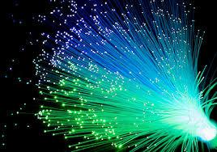
Course Outcomes
CO Number | Title On completion of this course, the students are expected to learn | Level
CO1 | Quote the basic fundamental concepts of lasers, optical fibres, crystallography, ultrasonic oscillations, semiconductor physics, quantum mechanics and nanotechnology. | Remember, Understand
CO2 | Demonstrate the working of various lasers, fibre components, semiconductor devices; explain the behaviour of crystalline solids, quantum and nano-scale systems. | Understand
CO3 | Solve problems by applying principles related to lasers, fibres, semiconductors, oscillations, quantum and nanoscience. | Applying
CO4 | Compare various lasers and fibres, semiconducting devices, crystalline materials, structures at quantum and nanoscale on the basis of their properties for industrial applications. | Analyze
CO5 | Develop various systems using lasers, fibres, semiconductors and nanomaterials for futuristic applications. | Design
Figure 2.1 Optical fibres [1]

Slide 4
Brief Flow of Presentation
Brief Introduction
Optical fiber construction
Critical angle & Total Internal Reflection
Acceptance angle & acceptance cone
Numerical Aperture
V-Number
Types of fibers
Dispersion & its types
Attenuation and Losses in Fiber
Advantages
Disadvantages
Applications
Figure 2.2 Basic structure and parts of optical fibre [2]

Slide 5
Definition of Optical fiber
An optical fiber is a flexible, transparent fiber made by glass (silica) or plastic to a diameter slightly thicker than that of a human hair.
Optical fiber is a dielectric waveguide and ideally has a cylindrical shape.
It consists of a core made up of a dielectric material which is surrounded by a cladding made up of a dielectric material of lower refractive index than core.

Slide 6
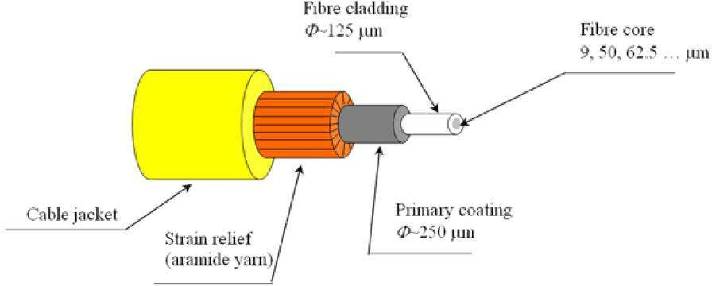
Parts of Optical Fiber
Core
Cladding
Buffering
Core having higher refractive index than cladding
Figure 2.3 Parts of optical fiber [3]

Slide 7
Core – thin glass center of the fiber where light travels.
Cladding– outer optical material surrounding the core.
Buffer Coating- plastic coating that
protects the fiber.

Slide 8
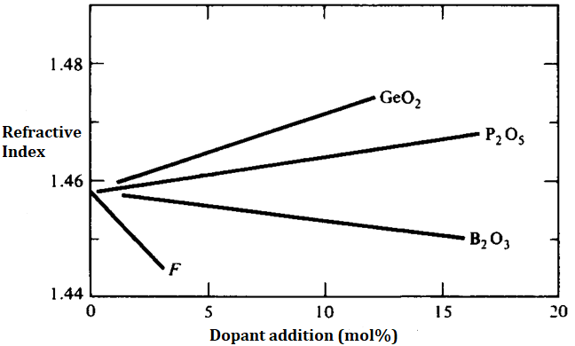
FIBER MANUFACTURE
I- Glass-Glass Fiber
Glass as silica (SiO₂) with refractive Index (RI) of 1.458 at 850nm
Addition of GeO₂ and P₂O₅ increases RI.
Addition of B₂O₃ and fluorine decreases RI.
Figure 2.4 Increase or decrease of RI by adding dopants [4].

Slide 9
FIBER MANUFACTURE
I- Glass-Glass Fiber
Combinations can be—
GeO₂ - SiO₂ core, SiO₂ Cladding.
P₂O₅ - SiO₂ core, SiO₂ Cladding.
SiO₂ core, B₂O₃ -SiO₂ Cladding.
GeO₂ - B₂O₃ - SiO₂ core, B₂O₃ -SiO₂ Cladding.
II- Plastic clad Glass Fiber
Glass core and plastic cladding.
Higher losses.
Short distance (several hundred meters).
Reduced cost.
Core Silicon resin RI = 1.405 at 850nm
Clad is Teflon PEP (Perfluoronated ethylene propylene) with RI = 1.338.
Large NA with large RI difference.
Core dia of 150 to 600µm.
LED as source.

Slide 10
FIBER MANUFACTURE
III- Plastic Fiber
Very short distance (100m max).
High attenuation.
Low cost, tough, durable, inexpensive.
Core dia of 110 to 1400µm.
LED as source.
Polystyrene core (1.6), methyl methacrylate clad (1.49). NA = 0.6.
Polymethyl methacrylate core(1.49), its co-polymer(1.40), NA = 0.5
Remember!
Germanium dioxide and phosphorus pentaoxide increase the refractive index of glass
Boron oxide decreases the refractive index of glass.
These oxides are known as dopants.
Changing composition of the mixture during the process influences refractive index profile of the preform

Slide 11
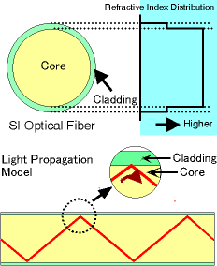
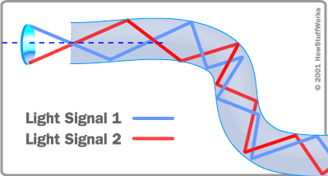
Transmission of Light Through Optical Fibers
Its total Internal Reflection
(a)
(b)
Figure 2.5 (a) & (b) Diagram of total internal reflection in different type of optical fiber [5].

Slide 12
Ray Theory Transmission
Refractive index
The index of refraction of a material is the ratio of the speed of light in a vacuum to the speed of light in the material
n = c/v
The factor n is the index of refraction (or refractive index) of
the medium.
For air and gases n ~ 1. At optic frequencies, the refractive index of water is 1.33.
Glass has many compositions, each with a slightly different
n. An approximate refractive index of 1.5 is representative for the silica glasses used in fibers; more precise values for these glasses lie between ~1.45 and ~1.48.

Slide 13
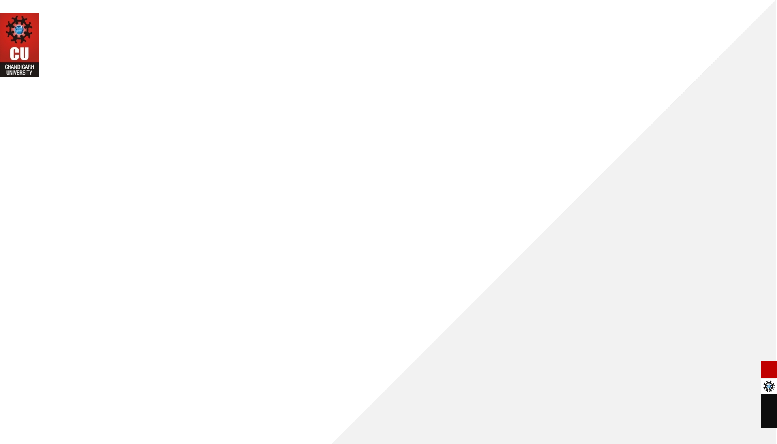
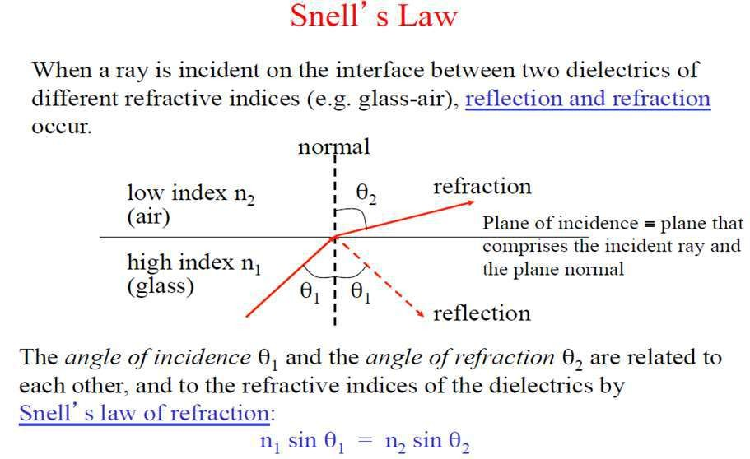
Ray Theory Transmission

Slide 14
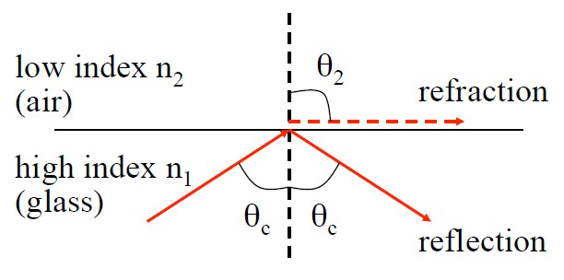
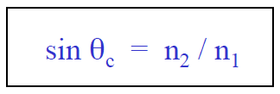

Critical Angle (θ_{c})
The angle at which total internal reflection occurs is called the critical angle of incidence.
At any angle of incidence (θ₁) greater than the critical angle, light is totally reflected back to the glass medium.
For n₁ > n₂, the angle of refraction θ₂ is always greater than the angle of incidence θ₁.
When the angle of refraction θ₂ is 90º the refracted ray emerges parallel to the interface between the media.

Slide 15
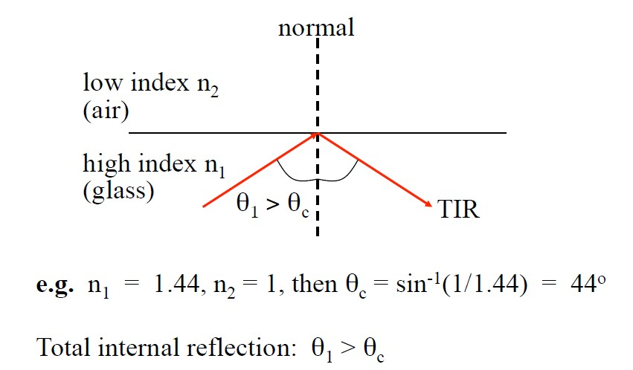
Total internal reflection
At angles of incidence θ₁ > θ_{c} the light is totally reflected back into the incidence higher refractive index medium. This is known as total internal reflection.

Slide 16
Refractive Index of Some Materials
Air -----------------------------------------------------------------------1.00
Water --------------------------------------------------------------------1.33
Magnesium fluoride --------------------------------------------------1.38
Fused silica (SiO₂)-----------------------------------------------------1.46
Sapphire (Al₂O₃)-------------------------------------------------------1.80
Lithium niobate (LiNbO₃)--------------------------------------------2.25
Indium phosphide (InP)----------------------------------------------3.21
Gallium arsenide (GaAs) ---------------------------------------------3.35
Silicon (Si)---------------------------------------------------------------3.48
Indium gallium arsenide phosphide (InGaAsP)-----------------3.51
Aluminum gallium arsenide (AlGaAs)-----------------------------3.60
Germanium (Ge) -------------------------------------------------------4.00
The index varies with a number of parameters, such as wavelength and temperature.

Slide 17
Assessment Test
Quiz link for Assessment Test:-
https://docs.google.com/forms/d/e/1FAIpQLSdoaR30UPyyOY0IRVyChKPoZVB99BOTYyw61SPEVbYoxNepFQ/viewform?usp=pp_url
Home Assignment :-
Q.1 Why silica is used for the fabrication of the optical fibers?
Q.2 What is the principle of fiber optical communication?
Q.3 Do signals really travel faster in fiber optics?
Q.4 What is a better way of communication, wire or fiber optics?

Slide 18
References
[1] https://www.ispreview.co.uk/index.php/2013/07/alcatel-lucent-breaks-record-with-31tbps-over-a-single-fibre-optic-cable.html
[2] http://constructionmanuals.tpub.com/14026/css/Fiber-Buffers-193.htm
[3] https://www.slideshare.net/ankushsaini123/6796optical-fibres
[4] https://www.slideshare.net/MadhumitaTamhane/optical-fiber-communication-part-1- optical-fiber-fundamentals
[5] (a) http://constructionmanuals.tpub.com/14026/css/Fiber-Buffers-193.htm
(b) https://computer.howstuffworks.com/fiber-optic2.htm
[6] https://www.slideshare.net/PratyushSrivastava8/optical-fiber-cable- v2?from_action=save
[7] https://www.ques10.com/p/21598/derive-the-expression-of-numerical-aperture- for-a-/
[8] https://www.explainthatstuff.com/fiberoptics.html
[9] http://fiberonda.com/single-mode-vs-multi-mode-fiber-optic-cable/
[10] https://images.app.goo.gl/LLWfgV3PjgLc9RbDA

Slide 19
Text book
Beiser A., Ghatak A, Garg S.C., Applied Physics, Edition 1st, (2013), Tata McGraw-Hill, Noida.
Laud B.B., Laser and Non -Linear Optics, Edition 1st, (1991), Wiley Eastern Ltd.
E- content
http://www.fiberopticshare.com/what-are-the-components-of-optical-fiber.html

Slide 20
THANK YOU
For Queries:-
deepak.e1972@cumail.in

